Slide 1
COVID19
Computational research project on the WHO COVID dataset
Group Members:
Kevin Sani
Basil Reji

Slide 2

Objective
Our goal is to analyze the WHO COVID data set and develop algorithms to extract insights, producing visualizations and predictive models that identify factors associated with the spread and severity of COVID-19 and evaluate public health interventions.
Using computational methods, we aim to gain a deeper understanding of the pandemic's impact on global health and produce actionable insights to inform public health policy and improve our response to COVID-19.

Slide 3
Dataset Used
The dataset from kaggle includes a wide range of COVID-19 related information, such as the number of confirmed cases, deaths, recoveries, active cases, critical cases, and tests conducted, as well as other demographic and socioeconomic indicators.
The data is updated daily and includes historical data of 209 countries going back to January 2020, allowing for longitudinal analysis of the pandemic's impact.

Slide 4
Analysis of Data
What is the most affected country?
How are the variables related to each other
Analyze data through different machine learning models to predict future covid-19 deaths
What is the best model to predict the future cases of covid-19

Slide 5
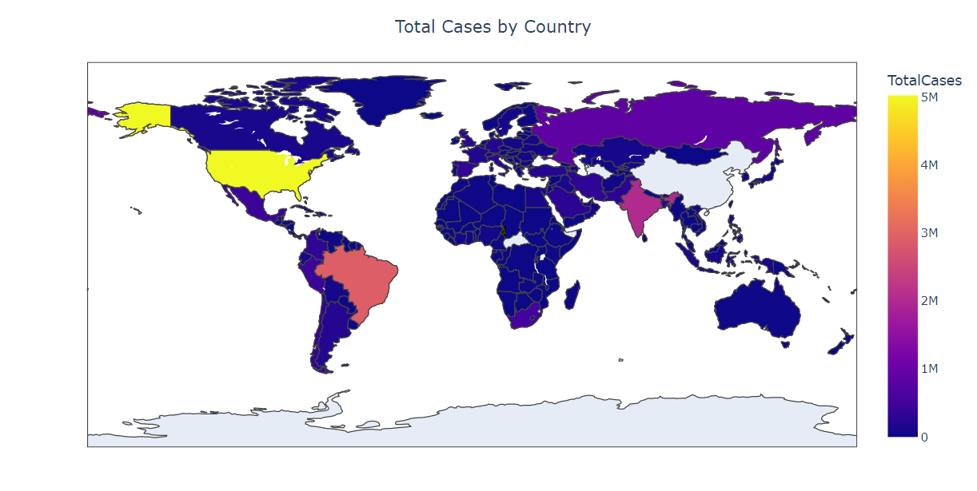
Total Cases By Country

Slide 6
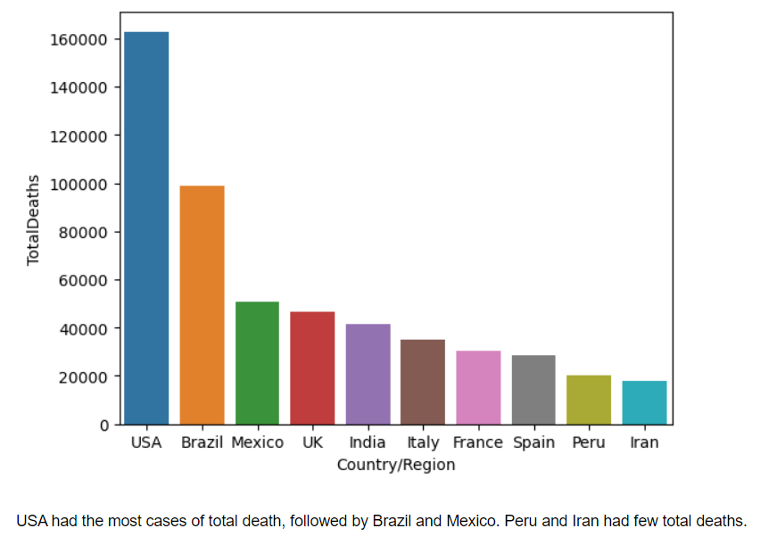
Most Affected Countries

Slide 7
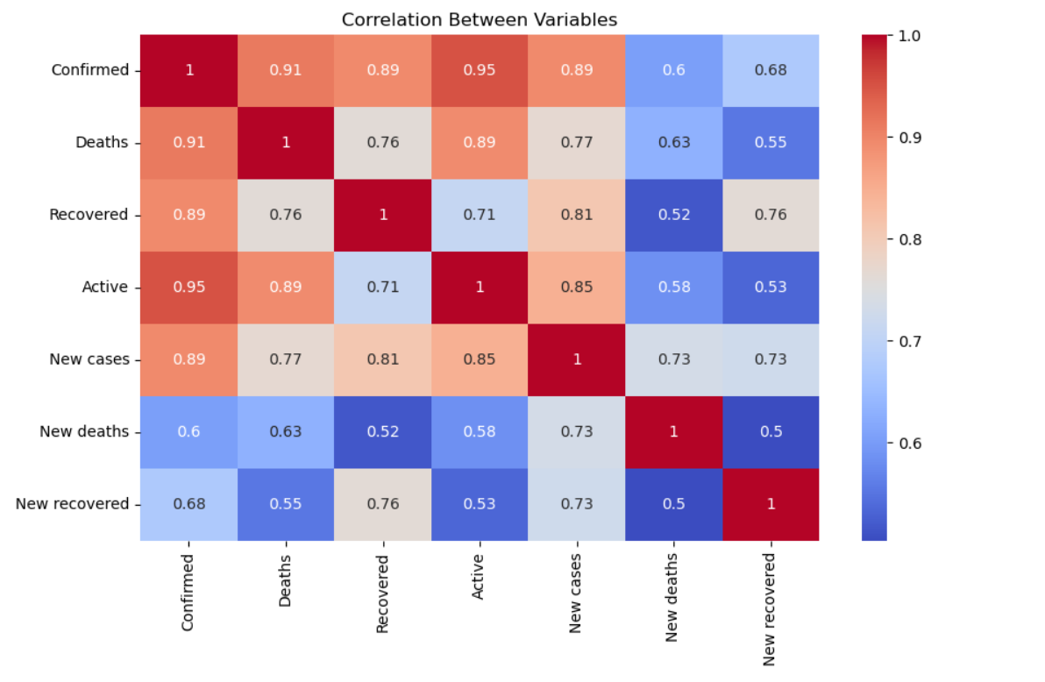

Slide 8
Inference from Correlation
Confirmed has a strong positive correlation with Deaths, Recovered, and Active. This makes sense, as the more confirmed cases there are, the more likely there will be deaths, recoveries, and active cases.
Deaths has a strong positive correlation with New deaths, indicating that the number of deaths is increasing over time.
Recovered has a strong positive correlation with New recovered, indicating that the number of recovered cases is increasing over time.
New cases has a strong positive correlation with New deaths and New recovered, indicating that the number of new cases is likely to be related to the number of new deaths and new recoveries reported on a given day.
Active has a strong positive correlation with New cases, indicating that the number of active cases is likely to be related to the number of new cases reported on a given day.

Slide 9
Model Evaluation
Run the dataset on the machine learning models.
Since the values are dated, we are not doing any random shuffling of the training and the testing data.
Prediction is done in the ascending order of dates.
Compute the mean squared error and R2 score to find the best model for prediction.
Also, a figure with the predicted and actual values is also shown to show how the data varies with the real data.

Slide 10
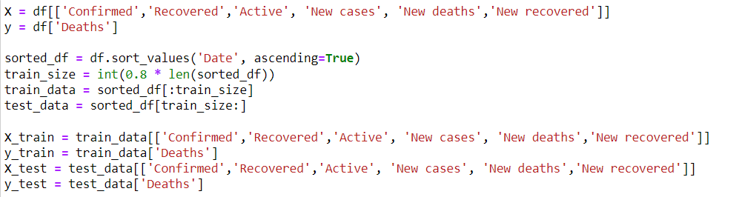

Slide 11
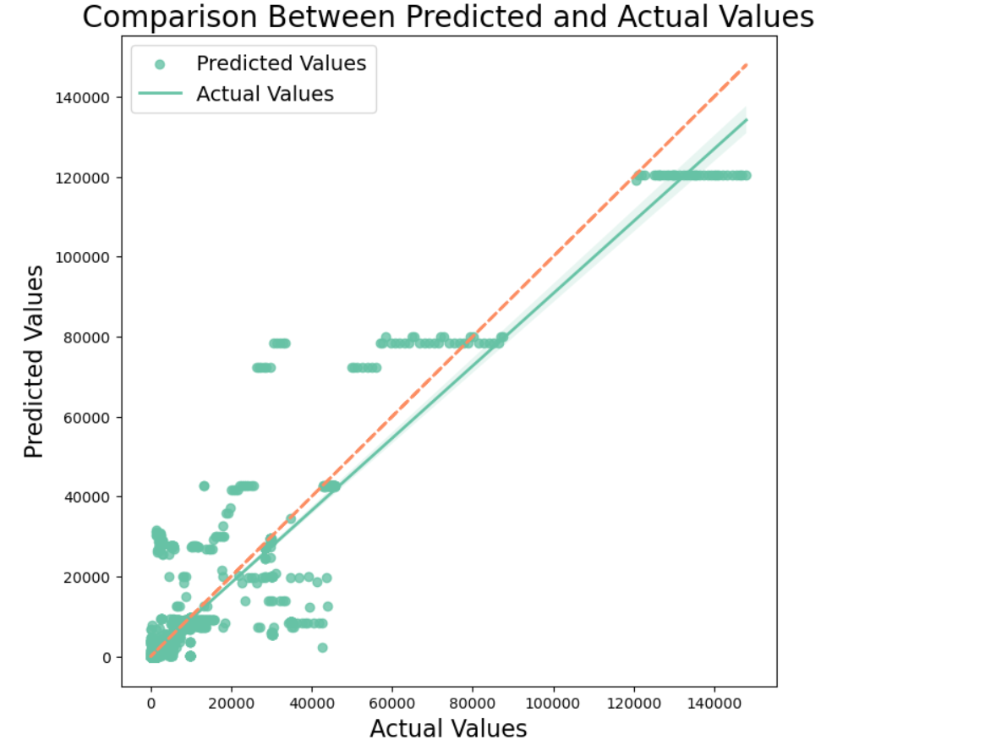
Decision Trees
RMSE: 4645
R2 Score: 0.858

Slide 12
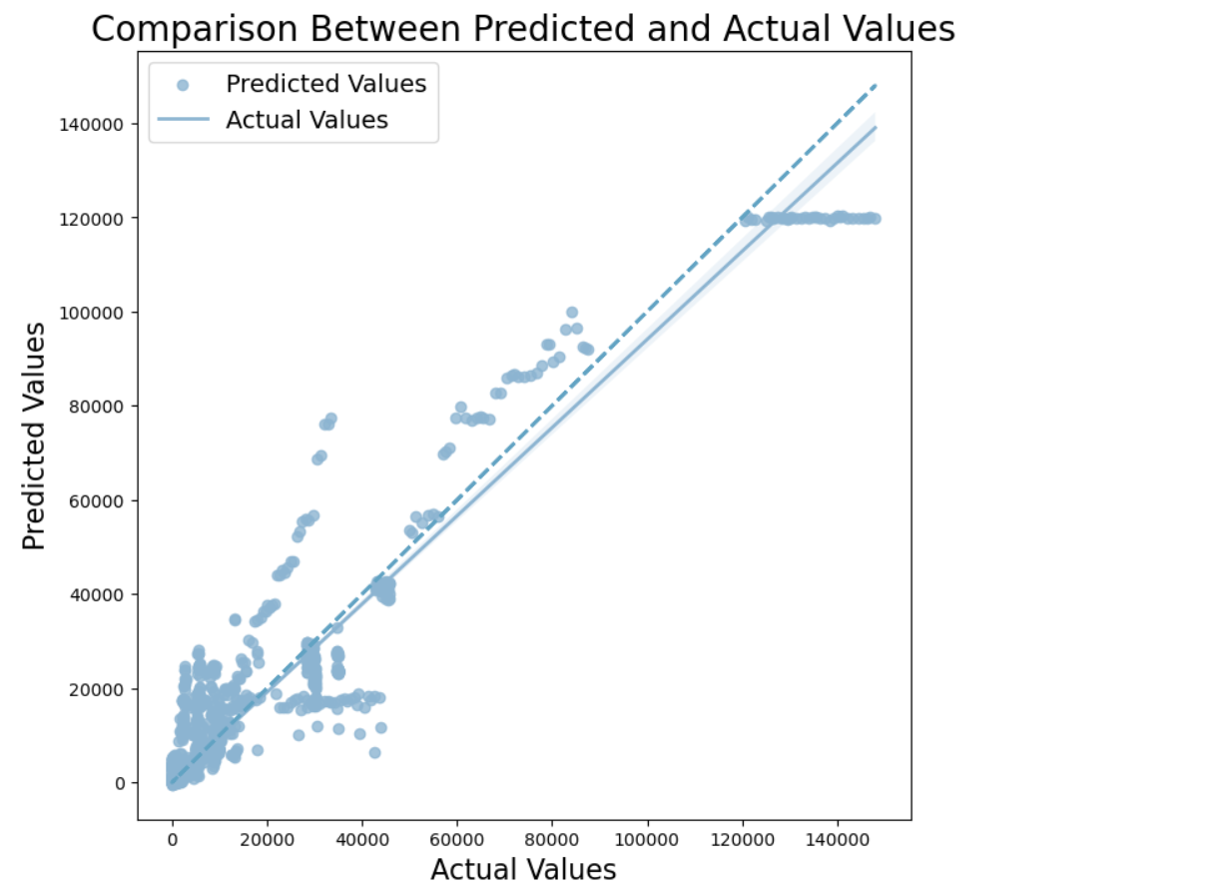
XGBoost
RMSE: 3485
R2 Score: 0.92

Slide 13
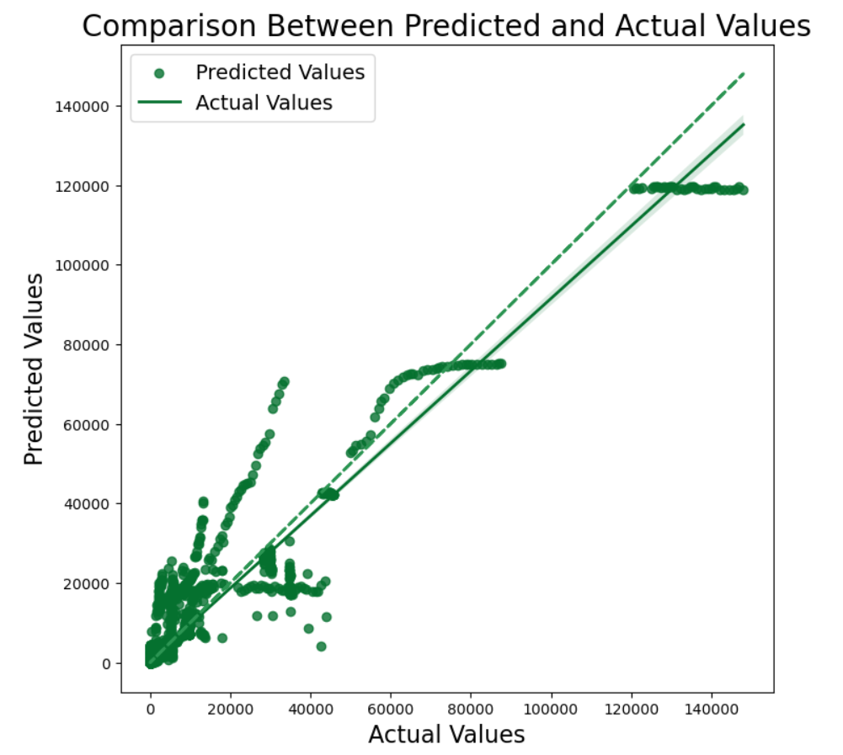
Random Forests
RMSE: 3475
R2 Score: 0.9207

Slide 14
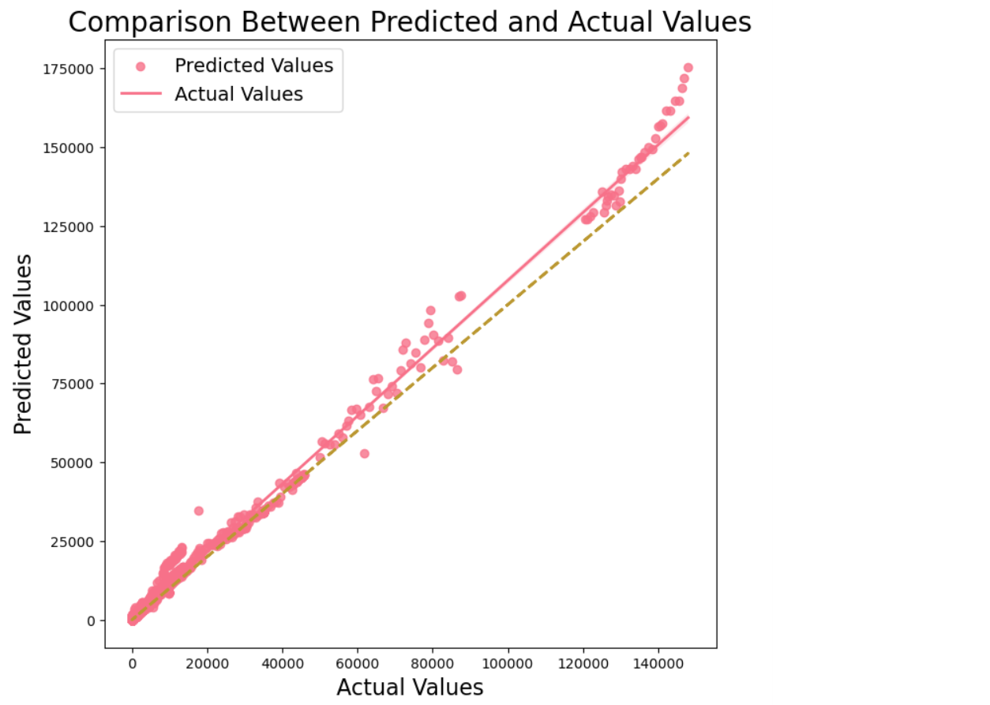
Neural Networks
RMSE: 1435
R2 Score: 0.969

Slide 15
Analysis of Model Evaluation
The best model seems to be the neural networks which has the highest R2 score here.
The high accuracy of the neural network model is likely due to its ability to model complex relationships between variables.
Decision trees is shown to have the least accuracy here.
Decision trees are limited in their ability due to the large variations of data here.
Random Forests and XGBoost have almost the same R2 score value but less than the neural networks model this maybe due to the fact that they are based on decision trees.

Slide 16
Work to be Done in Future
Use a broader dataset with more columns like vaccinations, GDP of a country, number of doses taken, population, etc.
Test the dataset with more models and algorithms.
There may be a case in the future where the current neural network model may not work well with the new dataset, so tune the network with more hyperparameters.

Slide 17
Conclusion
In conclusion, our analysis of the WHO COVID dataset has provided valuable insights into the impact of the pandemic on global health. By using machine learning models to analyze the data, we were able to identify key factors associated with the spread and severity of COVID-19.
We also found that neural network models outperformed decision trees, XGBoost, and Random Forest models in predicting COVID-19 deaths. However, we acknowledge the limitations of our analysis, including the quality of the data, the limitations of the machine learning models, and the need for further research and validation.
Despite these limitations, our analysis underscores the importance of using data-driven approaches to understanding the impact of the COVID-19 pandemic on global health, and the potential for machine learning models to inform public health interventions and policies. By presenting these findings, we hope to contribute to ongoing efforts to combat the COVID-19 pandemic and to inform public health decision-making more broadly.

Slide 18
Thank You

